Slide 1


Machine Learning to Simplify Complex Coronary Small Vessel Diagnostics
Research Fellow: Dr Dylan Tan
Supervisors: Dr Robert Sykes & Professor Colin Berry

Slide 2
Acknowledgements
Medical Research Council Impact Acceleration Account award
University of Glasgow MedTech Innovation Fund

Slide 3
Background
ANOCA
47% of patients with angina referred for coronary angiography.¹
INOCA
13% with inducible ischaemia on stress-testing.²
MINOCA
6% of patients with suspected MI.³
Compared to those with obstructive coronary disease:^{1,4}
Similar angina burden
Worse anginal limitations
Lower baseline QoL indices
At 10-year follow-up, 12.8% of patients with INOCA met a composite endpoint of cardiovascular-related death or myocardial infarction.⁵
Pooled 12-month mortality rate following MINOCA: 4.7%.³
Non-obstructive coronary arteries
1) Ford, T.J. et al. (2019) “Ischemia and No Obstructive Coronary Artery Disease: Prevalence and Correlates of Coronary Vasomotion Disorders,” Circulation: Cardiovascular Interventions, 12(12). Available at: https://doi.org/10.1161/CIRCINTERVENTIONS.119.008126.
2) Reynolds, H.R. et al. (2023) “Ischemia With Nonobstructive Coronary Arteries: Insights From the ISCHEMIA Trial,” JACC: Cardiovascular Imaging, 16(1), pp. 63–74. Available at: https://doi.org/10.1016/j.jcmg.2022.06.015.
3) Pasupathy, S. et al. (2015) “Systematic review of patients presenting with suspected myocardial infarction and nonobstructive coronary arteries,” Circulation. Lippincott Williams and Wilkins, pp. 861–870. Available at: https://doi.org/10.1161/CIRCULATIONAHA.114.011201.
4) Tavella, R. et al. (2016) “Natural history of patients with insignificant coronary artery disease,” European Heart Journal - Quality of Care and Clinical Outcomes, 2(2), pp. 117–124. Available at: https://doi.org/10.1093/ehjqcco/qcw034.
5) Noel Bairey Merz, C. et al. (2017) “Ischemia and No Obstructive Coronary Artery Disease (INOCA): Developing Evidence-Based Therapies and Research Agenda for the Next Decade,” Circulation, 135(11), pp. 1075–1092. Available at: https://doi.org/10.1161/CIRCULATIONAHA.116.024534.
Notes:
a) Ford, T.J. et al. (2019) “Ischemia and No Obstructive Coronary Artery Disease: Prevalence and Correlates of Coronary Vasomotion Disorders,” Circulation: Cardiovascular Interventions, 12(12). Available at: https://doi.org/10.1161/CIRCINTERVENTIONS.119.008126.
b) Reynolds, H.R. et al. (2023) “Ischemia With Nonobstructive Coronary Arteries: Insights From the ISCHEMIA Trial,” JACC: Cardiovascular Imaging, 16(1), pp. 63–74. Available at: https://doi.org/10.1016/j.jcmg.2022.06.015.
c) Pasupathy, S. et al. (2015) “Systematic review of patients presenting with suspected myocardial infarction and nonobstructive coronary arteries,” Circulation. Lippincott Williams and Wilkins, pp. 861–870. Available at: https://doi.org/10.1161/CIRCULATIONAHA.114.011201.
d) Tavella, R. et al. (2016) “Natural history of patients with insignificant coronary artery disease,” European Heart Journal - Quality of Care and Clinical Outcomes, 2(2), pp. 117–124. Available at: https://doi.org/10.1093/ehjqcco/qcw034.
e) Noel Bairey Merz, C. et al. (2017) “Ischemia and No Obstructive Coronary Artery Disease (INOCA): Developing Evidence-Based Therapies and Research Agenda for the Next Decade,” Circulation, 135(11), pp. 1075–1092. Available at: https://doi.org/10.1161/CIRCULATIONAHA.116.024534.

Slide 4
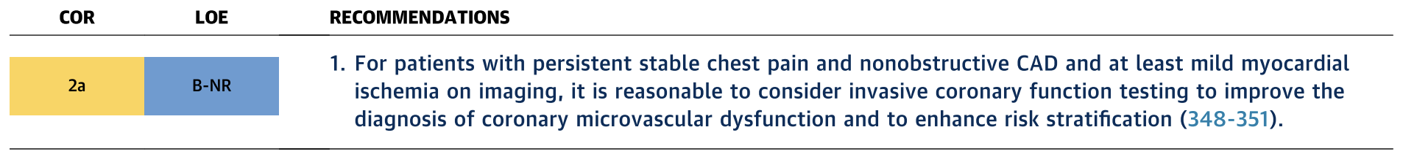
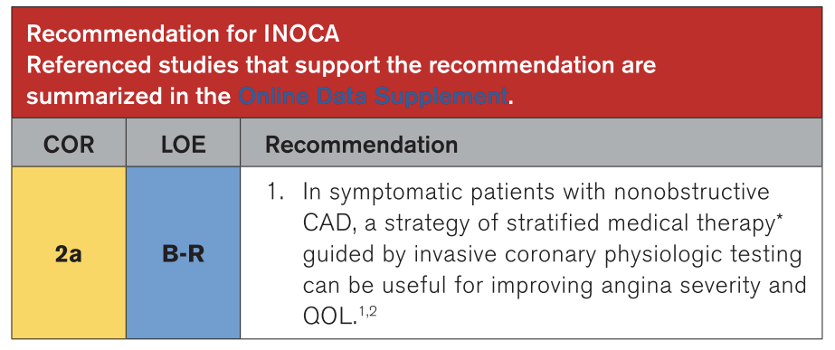
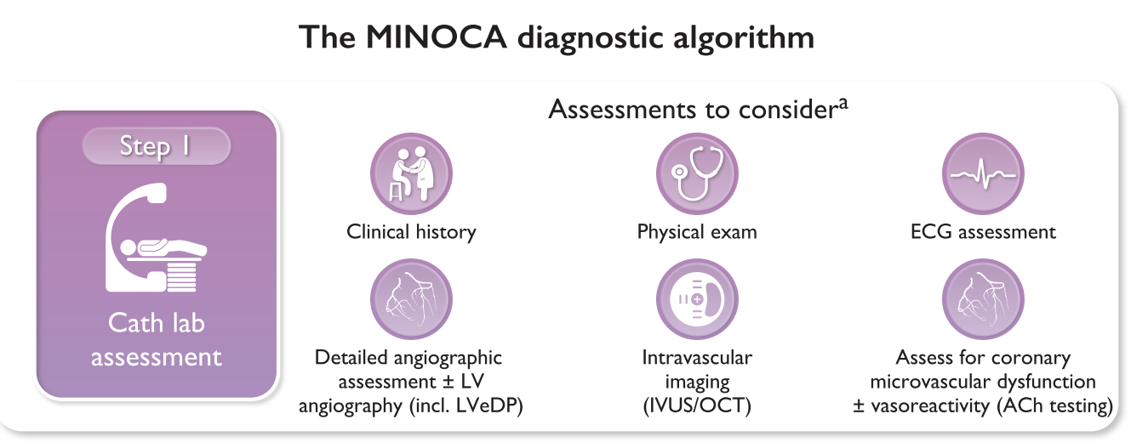
No obstruction – case closed?
AHA/ACC 2021 & 2023^{6,7}
ESC 2023 & 2024^{8,9}
6) Gulati, M. et al. (2021) “2021 AHA/ACC/ASE/CHEST/SAEM/SCCT/SCMR Guideline for the Evaluation and Diagnosis of Chest Pain: Executive Summary: A Report of the American College of Cardiology/American Heart Association Joint Committee on Clinical Practice Guidelines,” Journal of the American College of Cardiology, 78(22), pp. 2218–2261. Available at: https://doi.org/10.1016/j.jacc.2021.07.052.
7) Virani, S.S. et al. (2023) “2023 AHA/ACC/ACCP/ASPC/NLA/PCNA Guideline for the Management of Patients With Chronic Coronary Disease: A Report of the American Heart Association/American College of Cardiology Joint Committee on Clinical Practice Guidelines,” Circulation. Lippincott Williams and Wilkins, pp. E9–E119. Available at: https://doi.org/10.1161/CIR.0000000000001168.
8) Byrne, R.A. et al. (2023) “2023 ESC Guidelines for the management of acute coronary syndromes,” European Heart Journal, 44(38), pp. 3720–3826. Available at: https://doi.org/10.1093/eurheartj/ehad191.
9) Vrints, C. et al. (2024) “2024 ESC Guidelines for the management of chronic coronary syndromes,” European Heart Journal, 45(36), pp. 3415–3537. Available at: https://doi.org/10.1093/eurheartj/ehae177.
Notes:
f) Gulati, M. et al. (2021) “2021 AHA/ACC/ASE/CHEST/SAEM/SCCT/SCMR Guideline for the Evaluation and Diagnosis of Chest Pain: Executive Summary: A Report of the American College of Cardiology/American Heart Association Joint Committee on Clinical Practice Guidelines,” Journal of the American College of Cardiology, 78(22), pp. 2218–2261. Available at: https://doi.org/10.1016/j.jacc.2021.07.052.
g) Virani, S.S. et al. (2023) “2023 AHA/ACC/ACCP/ASPC/NLA/PCNA Guideline for the Management of Patients With Chronic Coronary Disease: A Report of the American Heart Association/American College of Cardiology Joint Committee on Clinical Practice Guidelines,” Circulation. Lippincott Williams and Wilkins, pp. E9–E119. Available at: https://doi.org/10.1161/CIR.0000000000001168.
h) Byrne, R.A. et al. (2023) “2023 ESC Guidelines for the management of acute coronary syndromes,” European Heart Journal, 44(38), pp. 3720–3826. Available at: https://doi.org/10.1093/eurheartj/ehad191.
i) Vrints, C. et al. (2024) “2024 ESC Guidelines for the management of chronic coronary syndromes,” European Heart Journal, 45(36), pp. 3415–3537. Available at: https://doi.org/10.1093/eurheartj/ehae177.

Slide 5
Functional Coronary Angiography
Standard coronary angiography
Diagnostic guidewire testing
Pharmacological reactivity testing
Coronary catheterisation with either 6Fr or 5Fr catheters.
LVEDP measured if feasible.
Pressure wire or Intracoronary doppler
FFR / CFR / IMR
Use of intravenous adenosine infusion or regadenoson
Intracoronary injection of vaso-reactive drugs.
Acetylcholine or Ergonovine
Individual centres are likely to have a local protocol for functional testing.
Overall, invasive testing may take around 20 minutes per coronary artery assessed.¹⁰
Furthermore, there is a 2% risk of complications arising from intra-coronary manipulations.¹¹
Despite the availability of technology and guidelines, uptake into standard practice remain limited.¹²
10) Ang, D.T.Y. et al. (2022) “Interventional Diagnostic Procedure: a Practical Guide for the Assessment of Coronary Vascular Function,” Journal of Visualized Experiments, 2022(181). Available at: https://doi.org/10.3791/62265.
11) Stables, R.H. et al. (2022) “Routine Pressure Wire Assessment Versus Conventional Angiography in the Management of Patients With Coronary Artery Disease: The RIPCORD 2 Trial,” Circulation, 146(9), pp. 687–698. Available at: https://doi.org/10.1161/CIRCULATIONAHA.121.057793.
12) Boivin-Proulx, L.A. et al. (2024) “Current State of Invasive Coronary Function Testing in Canadian Catheterisation Laboratories: A National Survey,” Canadian Journal of Cardiology, 40(11), pp. 2069–2071. Available at: https://doi.org/10.1016/J.CJCA.2024.05.020.
Notes:
j) Ang, D.T.Y. et al. (2022) “Interventional Diagnostic Procedure: a Practical Guide for the Assessment of Coronary Vascular Function,” Journal of Visualized Experiments, 2022(181). Available at: https://doi.org/10.3791/62265.
k) Stables, R.H. et al. (2022) “Routine Pressure Wire Assessment Versus Conventional Angiography in the Management of Patients With Coronary Artery Disease: The RIPCORD 2 Trial,” Circulation, 146(9), pp. 687–698. Available at: https://doi.org/10.1161/CIRCULATIONAHA.121.057793.

Slide 6
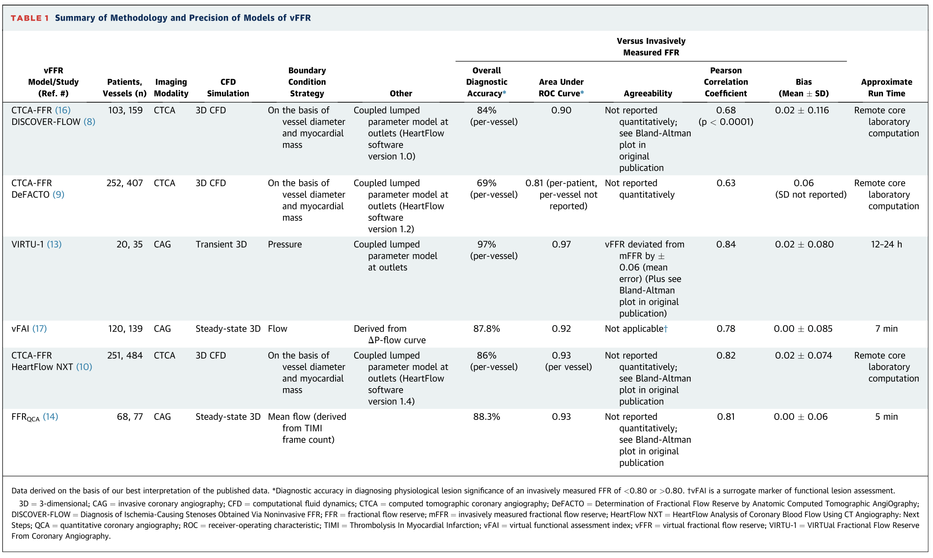
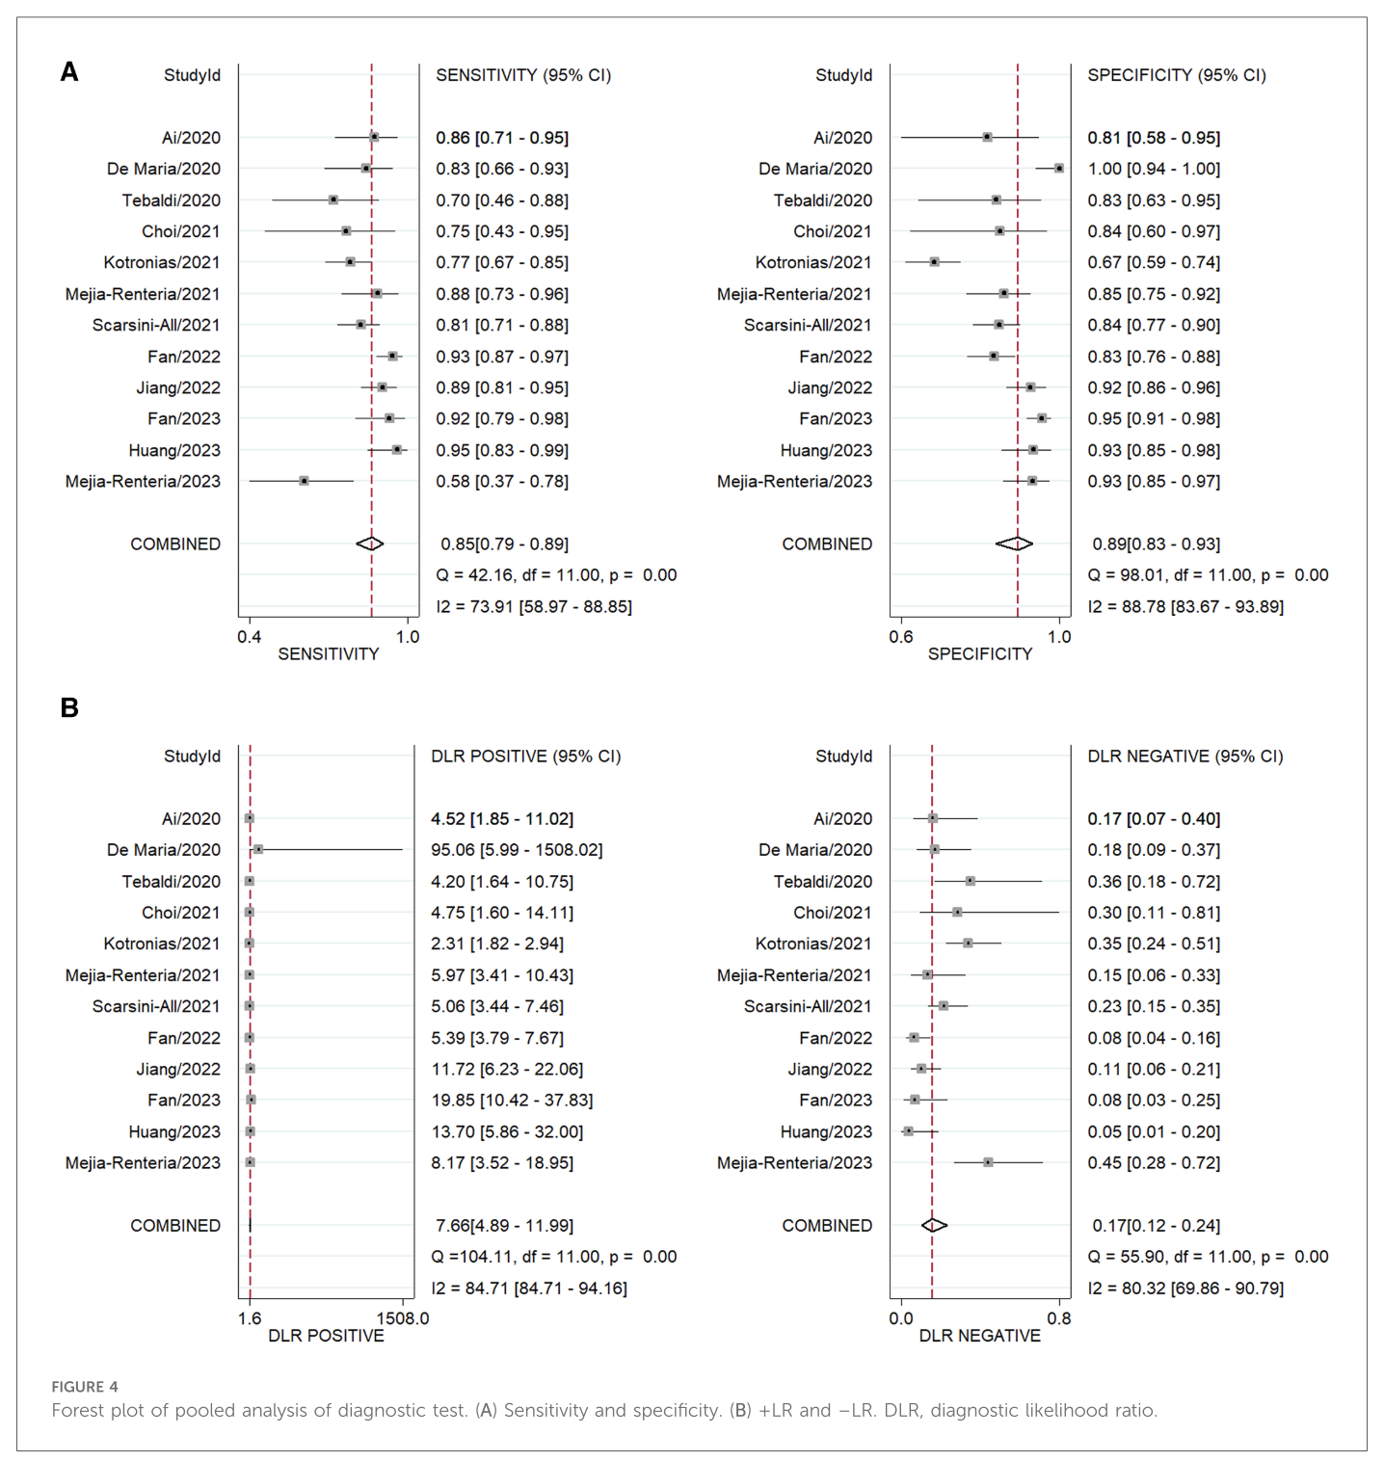
Computational Fluid Dynamics
Overall, good accuracy and AUC in predicting abnormal FFR (accuracy range 69%-97%, AUC range 0.81-0.97, r range 0.63-0.84) and IMR (meta-analysis sensitivity 85%, specificity 89%, AUC 0.93). ^{13, 14}
Limitations ¹⁵
A reliable CFD simulation requires high-quality imaging and accurate 3D reconstruction of the coronary artery lumen.
Heterogeneity in the definition of boundary conditions, particularly the distal outlet boundary conditions. ¹⁶
The computational time required may be lengthy (around 4 minutes, but can increase to hours). ¹³
The majority of CFD models utilise standard angiographic views under resting conditions – resulting in a double assumption in predictions. ¹⁷
13) Morris, P.D. et al. (2015) “‘virtual’ (Computed) Fractional Flow Reserve Current Challenges and Limitations,” JACC: Cardiovascular Interventions, 8(8), pp. 1009–1017. Available at: https://doi.org/10.1016/J.JCIN.2015.04.006.
14) Wang, D. et al. (2024) “Diagnostic and prognostic value of angiography-derived index of microvascular resistance: a systematic review and meta-analysis,” Frontiers in Cardiovascular Medicine, 11. Available at: https://doi.org/10.3389/FCVM.2024.1360648.
15) Candreva, A. et al. (2022) “Current and Future Applications of Computational Fluid Dynamics in Coronary Artery Disease,” Reviews in Cardiovascular Medicine, 23(11), p. 377. Available at: https://doi.org/10.31083/J.RCM2311377.
16) Scarsini, R. et al. (2021) “Angiography-derived index of microcirculatory resistance (IMRangio) as a novel pressure-wire-free tool to assess coronary microvascular dysfunction in acute coronary syndromes and stable coronary artery disease,” International Journal of Cardiovascular Imaging, 37(6), pp. 1801–1813. Available at: https://doi.org/10.1007/S10554-021-02254-8.
17) Scarsini, R. et al. (2023) “Angiography-Derived and Sensor-Wire Methods to Assess Coronary Microvascular Dysfunction in Patients With Acute Myocardial Infarction,” JACC: Cardiovascular Imaging, 16(7), pp. 965–981. Available at: https://doi.org/10.1016/J.JCMG.2023.01.017/SUPPL_FILE/MMC1.DOCX.
Notes:
* Candreva, A. et al. (2022) “Current and Future Applications of Computational Fluid Dynamics in Coronary Artery Disease,” Reviews in Cardiovascular Medicine, 23(11), p. 377. Available at: https://doi.org/10.31083/J.RCM2311377.

Slide 7
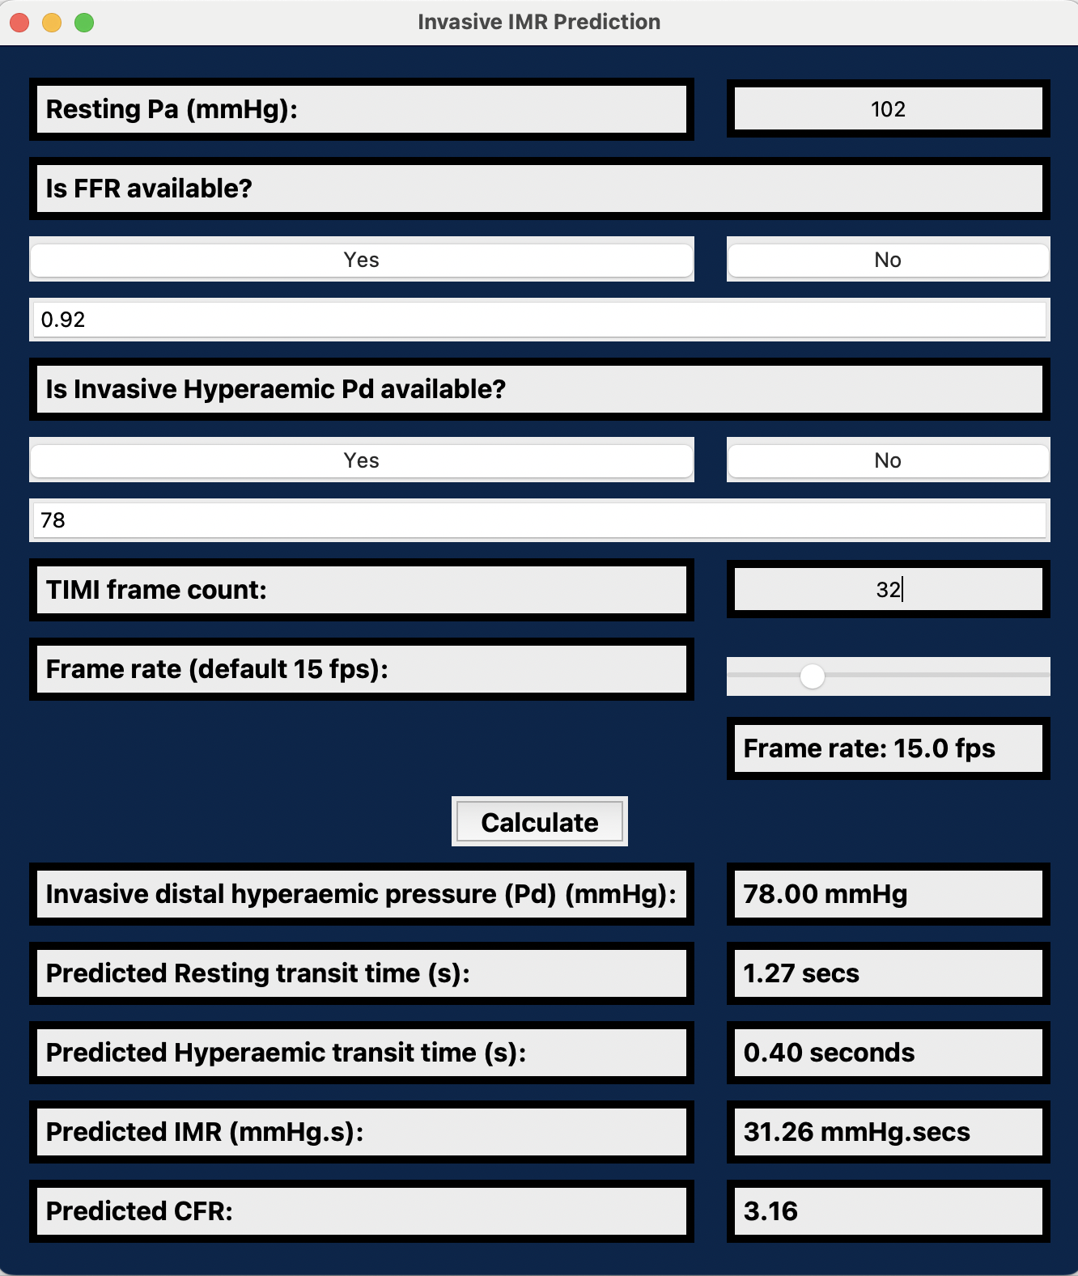
Machine Learning Model
Combined feature linear scale and multi-layer perceptron model.
Flexibility and interpretability when modelling complex, non-linear relationships.
Data efficient & Scalable.
Short computational time of around 20 seconds. ¹⁸
18) Zhao, Q. et al. (2023) “Angiography-based coronary flow reserve: The feasibility of automatic computation by artificial intelligence,” Cardiology Journal, 30(3), pp. 369–378. Available at: https://doi.org/10.5603/CJ.a2021.0087.

Slide 8
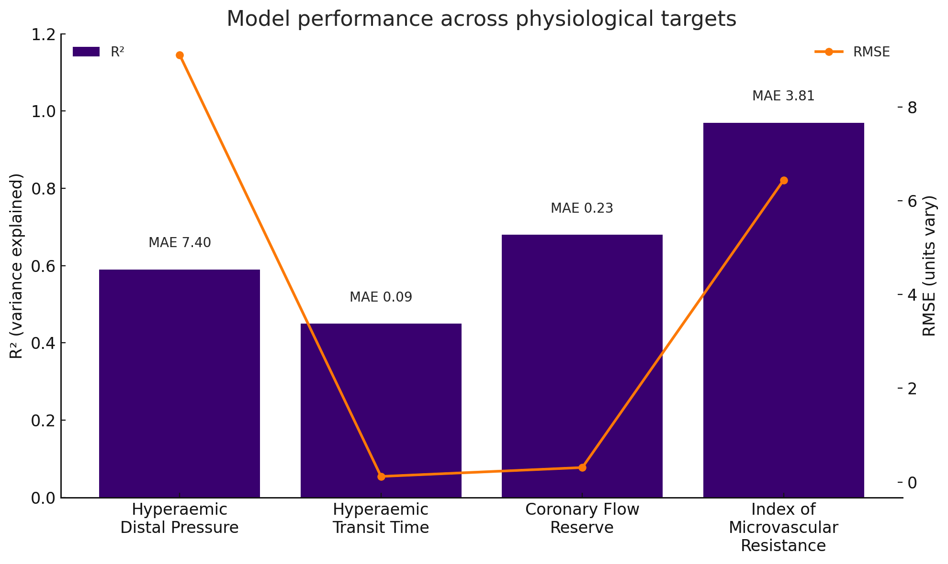
Retrospective internal validation
N=300

Slide 9
Preliminary Prospective Validation
N=100 | Pearson coefficient
IMR | 0.91
Hyperaemic transit time | 0.74
Hyperaemic Pd | 0.72
Prospective Adjunctive Binary Prediction of IMR ≥25
ROC AUC = 0.81 compared with Invasive IMR

Slide 10
Next steps: Coronary distribution as a potential node
Cross-sectional analysis of 199 vessels from 194 patients.
The patient cohort consisted of those who had a suspected myocardial infarction but had no obstructive coronary arteries (MINOCA).
Operators selected vessels according to clinical signs, such as ECG or echocardiographic changes. If no significant signs were detected, then the LAD was chosen as the default.
In conventionally labelled unobstructed coronary systems, baseline physiology parameters differed between the LAD and RCA, in keeping with previous work comparing physiology of unobstructed LAD and LCx. ¹⁹
Characteristic | LAD (n=168) | RCA (n=31) | P value
Resting TIMI frame count | 27 ±12 | 22 ±13 | 0.007
Resting Pd/Pa | 0.93 ±0.03 | 0.97 ±0.03 | <0.001
Resting Pd | 80±14 | 88±13 | 0.007
Resting Pa | 86±14 | 89±13 | 0.400
FFR | 0.88±0.05 | 0.95±0.05 | <0.001
Hyperaemic Pd | 70±15 | 79±14 | <0.001
Hyperaemic Pa | 78±16 | 83±14 | 0.14
Hyperaemic change in Pd/Pa (%) | 5.1±5.7 | 4.3±4.0 | 0.035
Resting Transit Time | 1.03±0.52 | 1.59±0.76 | <0.001
19) Demir, O.M. et al. (2025) “Pressure-Derived Indices in the Left Main Coronary Artery: Insights From Comprehensive In Vivo Hemodynamic Studies of Diseased and Unobstructed Vessels,” Circulation: Cardiovascular Interventions [Preprint]. Available at: https://doi.org/10.1161/CIRCINTERVENTIONS.125.015320.

Slide 11
Next steps: Surrogates of thermodilution recovery time to be explored
Multivariable linear regression against CFR | r (95% CI, p value)
 | Overall (n=199) | LAD (n=168) | RCA (n=31)
TIMI frame count | 0.03 (0.00 to 0.06, p=0.022) | 0.04 (0.01 to 0.07, p=0.011) | 0.01 (p=0.884)
Resting Pa (mmHg) | -0.05 (-0.08 to -0.02, p=0.003) | -0.05 (-0.08 to -0.01, p=0.010) | -0.07 (p=0.221)
Hyperaemic Pd (mmHg) | 0.06 (0.03 to 0.09, p<0.001) | 0.05 (0.02 to 0.08, p=0.003) | 0.11 (p=0.028)
Thermodilution recovery time | -4.35 (-5.52 to -3.17, p<0.001) | -4.18 (-5.39 to -2.97, p<0.001) | -5.65 (p=0.027)
Adjusted R² | 0.283 | 0.278 | 0.268
Multivariable linear regression against IMR | r (95% CI, p value)
 | Overall (n=199) | LAD (n=168) | RCA (n=31)
Resting transit time (s) | 8.06 (5.69 to 10.44, p<0.001) | 7.46 (4.54 to 10.38, p<0.001) | 7.05 (0.59 to 13.51, p=0.034)
Hyperaemic Pa (mmHg) | 0.22 (0.12 to 0.32, p<0.001) | 0.24 (0.13 to 0.35, p<0.001) | 0.04 (-0.37 to 0.44, p=0.852)
Thermodilution recovery time (s) | 38.91 (33.56 to 44.27, p<0.001) | 38.86 (33.29 to 44.42, p<0.001) | 42.63 (18.72 to 66.54, p=0.001)
Hyperaemic change in Pd (%) | -0.52 (-0.82 to -0.22, p=0.001) | -0.48 (-0.81 to -0.15, p=0.004) | -0.48 (-1.46 to 0.50, p=0.326)
Hyperaemic change in Pa (%) | 0.56 (0.25 to 0.87, p<0.001) | 0.52 (0.19 to 0.85, p=0.002) | 0.49 (-0.62 to 1.59, p=0.372)
Adjusted R² | 0.623 | 0.619 | 0.560

Slide 12
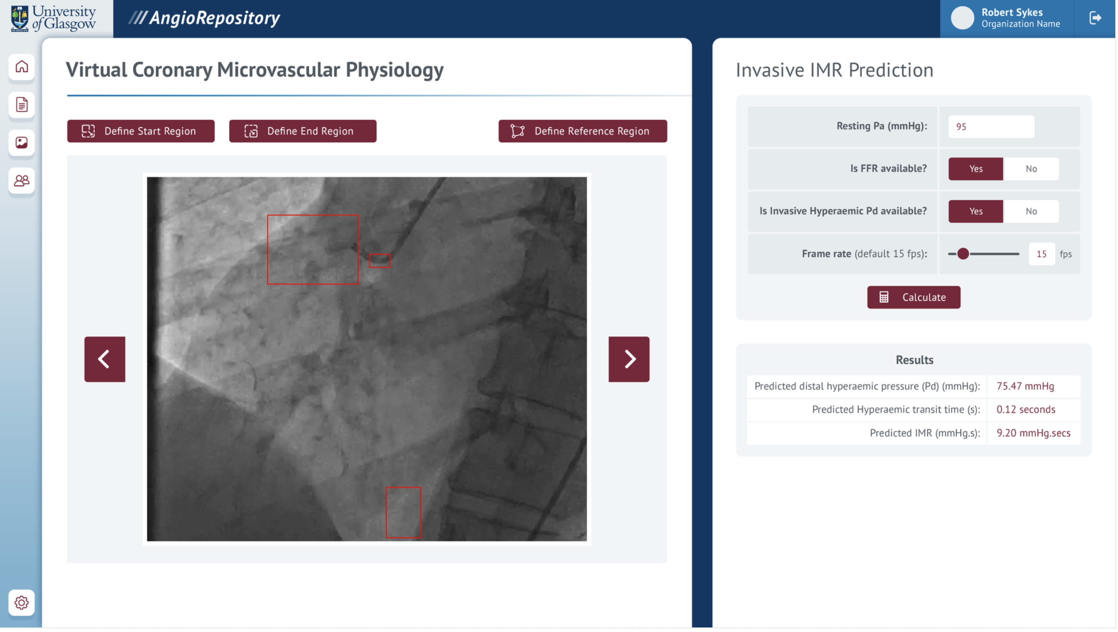
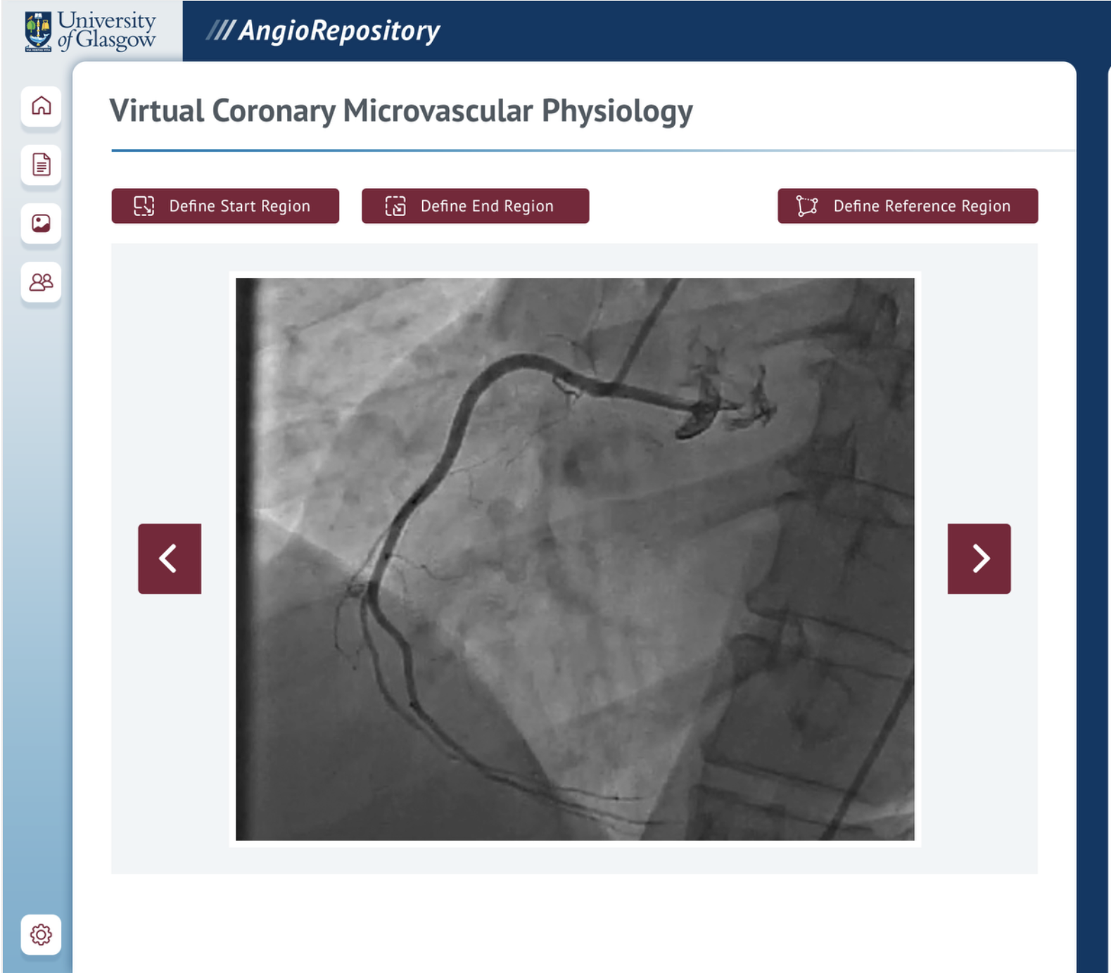
Next steps: Development of a scalable imaging & physiology upload infrastructure

Slide 13
Summary
Coronary physiology testing is an important adjunctive tool in diagnosing and prognosticating patients with angina or myocardial infarction, irrespective of obstructive CAD.
Intra-coronary manipulation, the duration of the procedure, and costs may contribute to the low uptake into common practice.
Predictive tools can help improve this aspect of the workflow. CFD models have been developed, but are currently limited by the computational time required and the cost of software subscription and implementation.
Preliminary results suggest that our machine-learning-enhanced model is feasible in aiding coronary physiology assessment; however, further iterations that include additional nodes may be required to enhance its accuracy.
Ultimately, further work will be undertaken to develop a scalable upload infrastructure, integrate it into current workflows, and conduct external clinical validation.

